Slide 1



IHTF objectives and value proposition
Unique platform for
High-level Ministerial dialogue on cross-border trade in H2 and derivatives, bringing together key prospective exporting and importing countries
Advancing public-private cooperation and dialogue between Ministers and CEOs of leading companies to align better priority actions to tackle key barriers to and enablers for cross-border trade
Taking stock of key insights from the relevant analyses on the topic carried out by international organizations and initiatives

Slide 2

















IHTF at a glance: roles and key milestones
      Co-Chairs*
      Country members**
      Technical coordinator
      Private sector
      engagement coordinator
*Co-chairs rotate
on an annual basis
**Other countries in process of joining the IHTF
Oct 2023:
1st working group meeting of IHTF
May 2024, World Hydrogen Summit, Rotterdam, NL:
Launch 2nd Ministerial-CEO roundtable on priority corridors
Nov 2025, COP30, Belem, BR:
TBC: 4th Ministerial-CEO roundtable
July 2023:
Launch of IHTF at CEM14 in India by NL and UAE as launching co-chairs
Dec 2023, COP28, Dubai, VAE:
1st Ministerial-CEO roundtable & Public Private Action Pact launch
Oct 2024, G20/CEM:
high-level side event on the “big three”

Slide 3


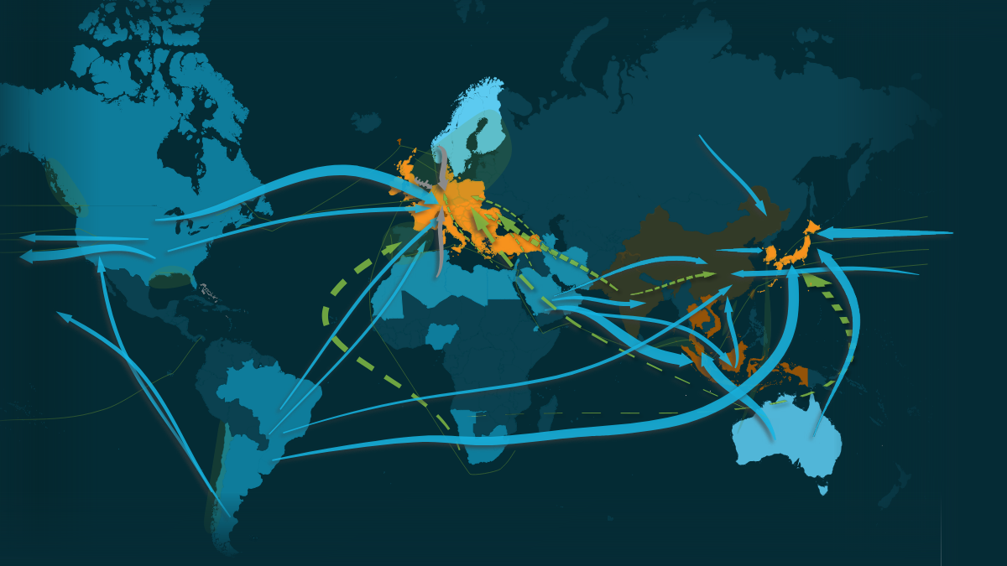
IHTF high level roundtables: main outcomes & conclusions
1
Declaration of Intent on mutual recognition of
certification schemes for hydrogen and its derivatives
Assess
2
ISO Methodology for GHG emissions
assessment for Hydrogen on an LCA basis
Evidence
3
Public-Private Action Statement on unlocking trade corridors
Deploy
1
Global Hydrogen trade can maximize value for climate, society and economy. We need to act fast to unlock these benefits
2
Countries and companies are already deploying ambitious strategies and projects. There have even been already several shipments of low-emission hydrogen derivatives taken place
4 key enabling conditions have been identified:
Long-term commitment from demand centers
2. Urgent establishment and interoperability of standards and certification
3. Capacity building and knowledge sharing
4. Unlocking finance, specially for emerging economies
3

Slide 4

Way forward
  Activation Roadmaps for emerging corridors to be presented at COP30.
    Identification of actionable commitments to accelerate investments in the H2 supply chain and global H2 trade that can serve as a basis for setting voluntary targets in the framework of COP
    Real world examples will be used to extract best practices and to address barriers in light of accelerating the international hydrogen trade.
  Ministerial-CEO roundtable at COP30 to discuss activation roadmaps and key enablers for the development of international low-emissions supply chains and trade corridors of H2 and derivatives

Slide 5



40% lower cost and up to 10 mn jobs created in the global H₂ economy by 2035
Socio-economic benefits unlocked by global trade routes
  40% lower
  cost for consumers
  from H₂ trade
Production
  7-10 mn
  jobs created
  850 Mt CO₂
  abated annually through clean hydrogen supply
Consumption
Notes:
Updated 20.06.2023
v2.7.8d3 – FA 990
Link to new spreadsheet:
https://mckinsey.box.com/s/w4oxes4838yifb8ke3bd5jtdtap60n72

Slide 6
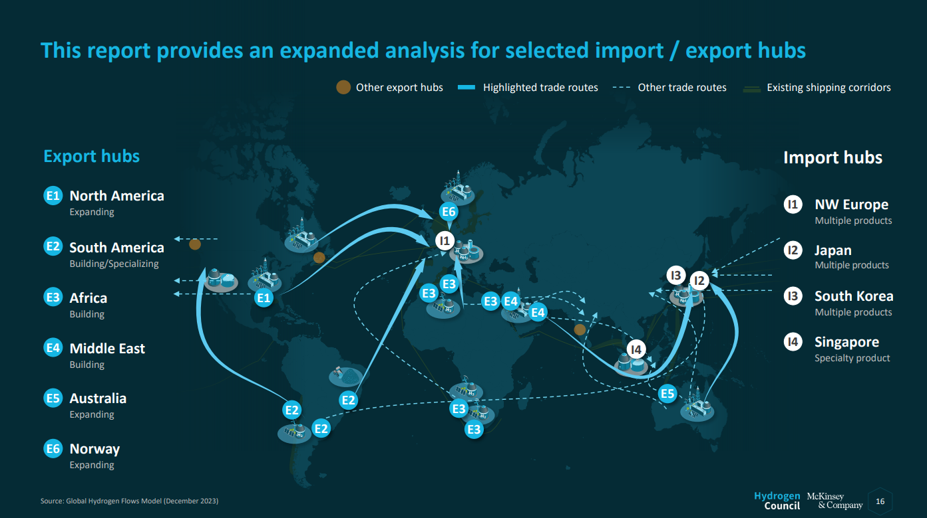

Slide 7
